Slide 1
Medicinal plants containing Saponins

Slide 2
Saponins
Saponins are found in many plants and gained their name because like soap, they form a lather when combined with water.
Chemically they are based on a Steroid or Triterpene fat-soluble base joined to a water-soluble sugar molecule. Note: Both steroid & Triterpene types usually found existing together.
In plants saponins are found especially in plant skins where they form a waxy protective coating. It has also been found that saponins are a major part of the plants’ active immune system and function as a ”natural antibiotic” for plants.

Slide 3
The chemical structure of steroidal saponins is similar to that of many of the body’s hormones, for example estrogen and cortisol, and many plants containing them have a marked hormonal activity. Their aglycone portion is referred to as the sapogenin. Note: the steroidal saponins in Dioscorea villosa (Wild Yam) were the basis from which the contraceptive pill was first developed and currently many bioidentical hormones.

Slide 4
Triterpenoid saponins have less hormonal activity. They are often expectorant and will aid absorption of nutrients.
Among the chemical properties of saponins, their polarity, hydrophobicity and nature of the reactive groups seem important determinants of their biological properties, and has also made them difficult compounds to both isolate and research.

Slide 5
Major Actions of Saponins in the Body
Properties of saponin containing herbs are many & varied and may include alterative, diuretic, expectorant, anti-catarrhal, anti-inflammatory, antispasmodic, aphrodisiac, antioxidant, emmenagogue, cardiac stimulant, hormone modulating, hepatoprotective, and adrenal adaptogenic effects. Possibly their most important property is to accelerate the body’s ability to absorb other active compounds. Some of their more specific noted effects include:

Slide 6
Hepatoprotective providing Kuppfer cell support in the liver promoting detoxification
Adaptogen (or Adrenal tonic effect) & Hormone modulating by mimicing our endogenous hormones and specifcally sparing cortisol
Stimulating expectorant effect via activation of mucociliary escalator and mucous membrane irritation
Diuretic effect via local irritation of kidney epithelia
Gentle Detoxifiers eliminating toxic buildup in various ways throughout the body

Slide 7
Cholesterol lowering by binding with cholesterol so it cannot be re-absorbed into the system. Bile acids form mixed micelles with cholesterol, facilitating its absorption. Saponins cause a depletion of body cholesterol by preventing its reabsorption, thus increasing its excretion, in much the same way as other cholesterol-lowering drugs (sequestrants).
Note: The binding of bile acids by saponins has other important implications, as primary bile acids are metabolized by bacteria in the colon, producing secondary bile acids which can be promoters of colon cancer (see anti-cancer effects).

Slide 8
Anti-cancer – The proposed mechanism of anti-carcinogenic properties of saponins include antioxidant effect, direct and select cytotoxicity of cancer cells, immune-modulation, acid and neutral sterol metabolism and regulation of cell proliferation. Cancer cells also have more cholesterol-type compounds in their membranes than normal cells, thus as saponins can bind cholesterol and they may interfere with cell growth and division of cancer cells.

Slide 9
Toxicity Effects
Saponins can have an irritating effect on mucous membranes of the respiratory and digestive tract, potentially causing sneezing, bloating, gastroenteritis, nausea, diarrhea, and vomiting.
Saponins have also been noted for their hemolytic properties as they can effectively “dissolve” the cell walls of red blood cells and disrupt them when taken intravenous or intramuscularly. When take orally however they are comparatively harmless or they are not absorbed at all.

Slide 10
Note: Humans generally do not suffer severe poisoning from saponins. Our cholesterin inactivates them so that only our mucus membranes are affected. Some however are poisonous if swallowed and can cause urticaria (skin rash) in many people. Any markedly toxic saponin is known as a sapotoxin.

Slide 11
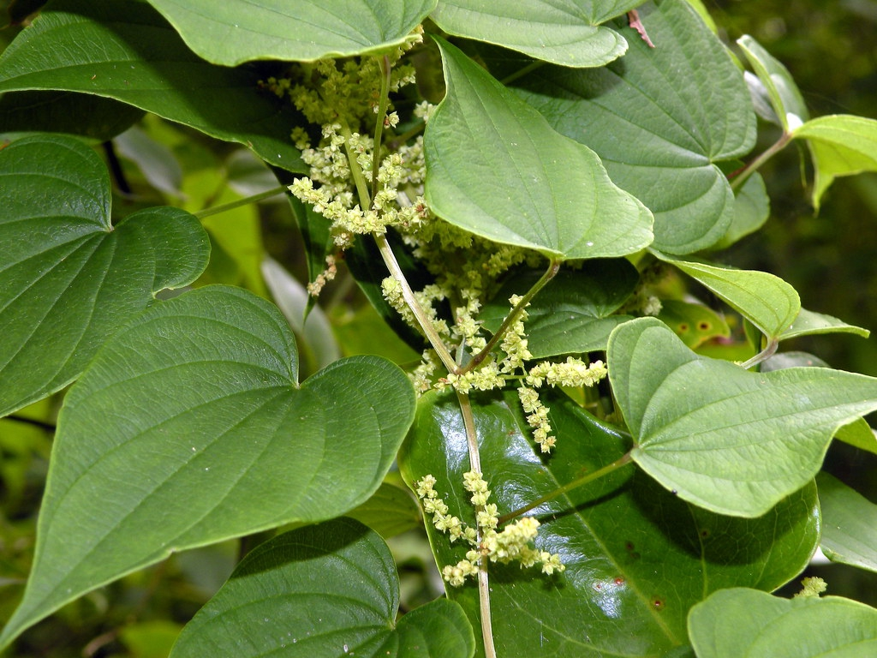
Dioscorea villosa
Common name: Wild yam
Family: Dioscoriaceae
Parts used: Root

Slide 12
Constituents:
Steroidal saponins based on diosgenin (dioscin, dioscorin, and others), Starch, Alkaloids, Tannins, Phytosterols
Medicinal actions:
Antispasmodic, anti-inflammatory, anti-rheumatic, cholagogue, diaphoretic, analgesic, anti-tussive, anti-asthmatic, expectorant, anti-diabetic, vasodilator, cardiac sedative, bitter, hepatic, diuretic

Slide 13
Medicinal use:
Is most indicated in inflammatory conditions of the gastrointestinal tract, joints, uterus and ovaries. Wild yam reduces the inflammation and pain associated with intestinal cramping. This may occur as part of inflammatory bowel disease, flatulence, diverticulitis, and nausea and vomiting. Has specific use for bilious colic. Will aid in all types of arthritis, joint/muscle pain, neuralgias and inflammations.

Slide 14
Pharmacology:
It is believed that the anti-inflammatory action is due to steroidal effects.
Steroidal saponin disocin yields diosgenin which is used for the manufacture of progesterone, hydrocortisone, and other hormones.
It is not clear that the body can convert disogenin to progesterone or other hormones.

Slide 15
Pharmacy: Tincture: (1:2, 60%), 1-2 ml QD. Acute: 2.5 ml q ½ hour; weekly maximum dosage 100 ml. Decoction: 1-2 tsp root/cup water, decoct 15 min; Chronic: 1 cup TID; Acute: ½-1 cup q ½ hour. Dried root: 2-4g, TID.
Toxicity: None known. High doses may cause nausea, vomitting, diarrhea.
Interactions: None known.

Slide 16
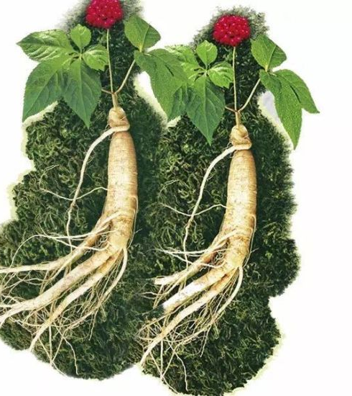
Panax ginseng
Common name: Chinese or Korean ginseng
Family: Araliaceae
Parts used: Root

Slide 17
Constituents:
Mixture of steroidal and triterpenoid saponins (ginsenosides), polysaccharides (glycans), acetylenic compounds including polyacetylenic alcohols (panaxynol and panaxydol) and polyacetylenes (ginsenoynes A-K), sesquiterpenes (B-elemene, panasinsanol A and B, ginsenol, etc.). Sterols; Vit. D group vitamins; Flavonoids; Amino acids, volatile oils, galactose

Slide 18
Medicinal actions:
Adaptogen, general stimulant & tonic, nervous system relaxant/stimulant, sedative, anti-depressant, anxiolytic, hypoglycemic, analgesic, antioxidant, immuno-modulator, hepatoprotective, cardiotonic, vasodilator, anti-cholesterol, demulcent, male tonic, aphrodisiac, diuretic, antispasmodic

Slide 19
Medicinal use:
Ginseng is used to improve mental & physical stamina and performance as well as promote longevity. It promotes metabolism and growth of normal cells and accelerates development of both the brain and body. Increases muscle mass and resistance to biological, chemical and physical stress. In women, ginseng promotes an estrogenic effect, and in men can enhance fertility and especially low libido.

Slide 20
Pharmacology:
Steroidal saponins (ginsenosides, ginpanaxosides) have corticosteroid-like action and inhibit re-uptake of GABA, NE, dopamine, gluatmate, and serotonin.
The individual ginsenosides may have opposite effects such as vasoconstriction & dilation, increase & decrease cardiac performance, hemostatic & anti-coagulant, and CNS stimulant & depressant.
Polysaccharides are hypoglycemic and anti-tumor.

Slide 21
Pharmacy:
Dried root: short-term 0.5-2g QD, long-term 0.4-0.8 QD (100 mg capsule standardized to 4-7% ginsenosides: 100-200 mg daily). Decoction: 1 tsp/cup, simmer 10 min TID. Tincture: (1:5, 60%), 1-2 ml TID. Pause dosing 6 week on 4 weeks off, avoid long-term use unless in low doses.
Toxicity:
No adverse effects expected. Overdose can cause palpitations, insomnia, chest pain, headaches and epistaxis. Reports on side effects are controversial due to lack of information on the type of ginseng used in studies.

Slide 22
Contraindications: Acute asthma, hypertension, acute infections. Use caution with acute infection and inflammatory diseases, in hyper tense people and in children.
Interactions: Avoid use with other stimulants. Theoretically interact with anti-psychotics, anti-hypertensives, anti-coagulants and other hormone therapies.

Slide 23
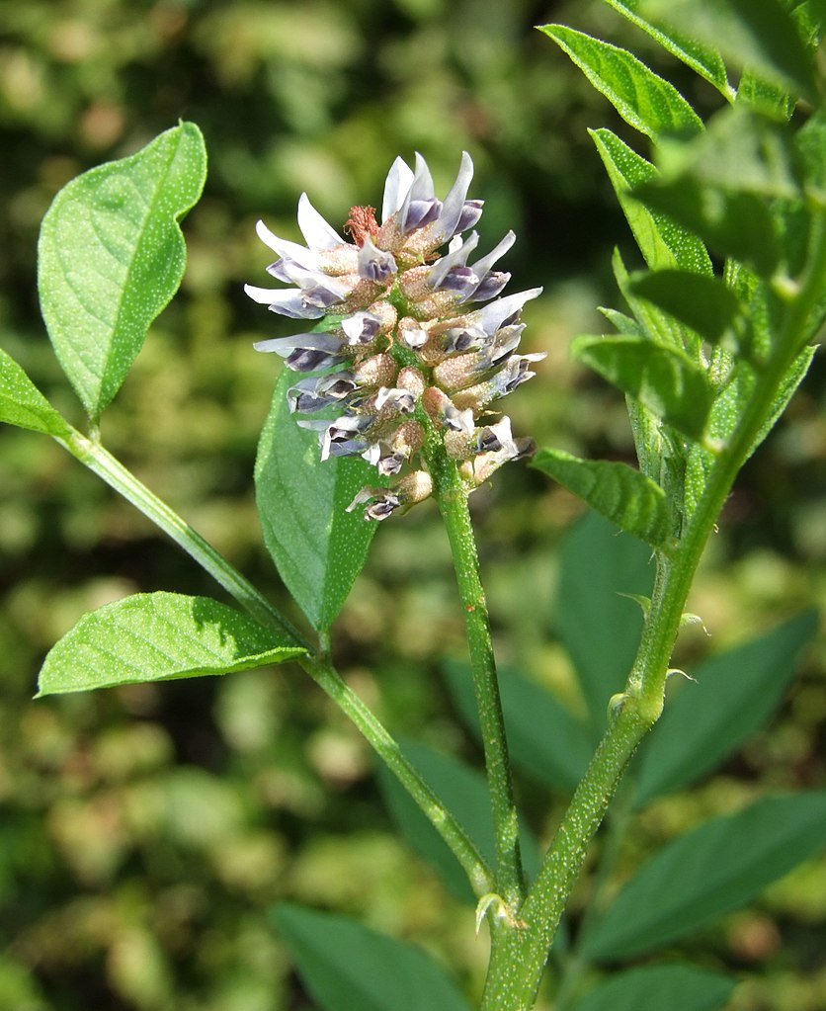
Glycyrrhiza glabra
Common name: Licorice, Liquorice
Family: Fabaceae
Part used: Dried root & rhizome

Slide 24
Constituents:
Triterpene saponins (glycyrrhizin, glycyrrhizic & glycyrrhetinic acid), flavonoids, iso-flavonoids, phytosterols, polysaccharides (glucans), coumarins, volatile oils, amino acids, gum, lignans, starch, sugars
Actions:
General tonic, anti-depressant, adrenal restorative, adrenal tonic, anti-tumor, anti-viral, anti-inflammatory, anti-tussive, mucoprotector, expectorant, detoxifier, demulcent, hepatoprotector, anti-ulcer, mild laxative, aldosterone-like action, anti-spasmodic

Slide 25
Medical uses:
Is specific for the treatment of peptic ulcers and Addison’s disease. Also used for adrenal insufficiency, corticosteroid withdrawal, hypoglycemia and protection against cataracts in diabetes. Inflammatory conditions also benefit from it’s use such as allergies and autoimmune disease, lyme disease, and protects against carcinogens. It will soothe gastrointestinal inflammation and irritations. For rheumatism, muscle spasm & cramps, and joint inflammation it can be used both internally and topically.

Slide 26
Pharmacology:
Triterpene saponins (glycyrrhizin, glycyrrhizic acid) antagonize effect of estrogen, inhibit growth of HIV & DNA/RNA viruses, and are anti-inflammatory.
Glycyrrhetinic acid is an aglycone similar to natural corticosteroids which have an adrenocorticomimetic action. Is also anti-viral, hepatoprotective, inhibits EBV activation and is anti-inflammatory and anti-tumor.
Flavonoids and isoflavonoids are anti-microbial and estrogenic.
Phytosterols have an estrogenic action.
Polysaccharides (glucans) are demulcent.
DGL (deglycyrrhinized licorice) is a preparation where most of the GL has been removed. It inhibits the formation of ulcers, reduces gastric secretions, and protects gastric mucosa against damage.

Slide 27
Pharmacy: Powdered root: 1-4g TID. Decoction: 1 tsp/cup, simmer 15 min, TID. Tincture: (1:1, 20%) 2-6ml QD.
Contraindications:
Use with caution in anemia, hypertension, cardiovascular disorders, edema associated with heart failure, liver problems, kidney insufficiency, hypokalemia, hypothyroidism, fibrocystic breasts, male infertility or erectile dysfunction.

Slide 28
Toxicity: Minimal adverse effects if intake is less than 10mg/day. Long term use may reduce thyroid function and basal metabolic rate. High doses of long term use may cause hypokalemia, symptoms of hyperaldosteronism and amenorrhea.
Interactions: With diuretics, cardiac glycosides, corticosteroids, MAOIs, blood pressure medications, spironolactone, hormonal therapies, laxatives and K+ depleting medications.

Slide 29
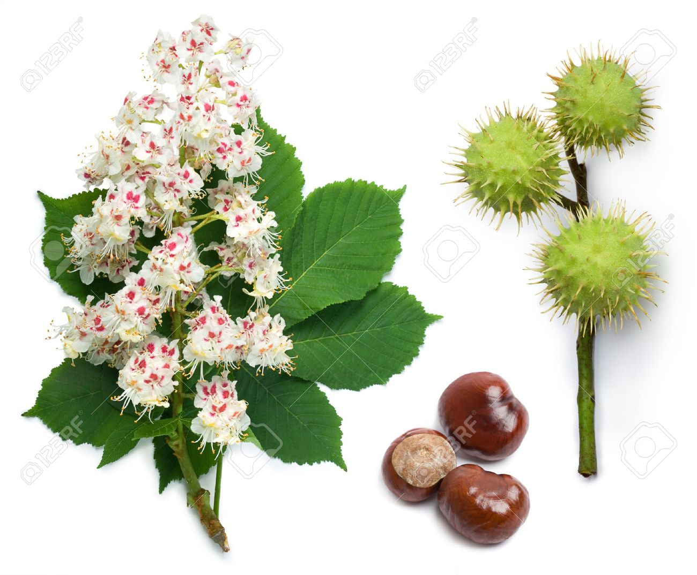
Aesculus hippocastanum
Common name: Horse chestnut
Family: Hippocastanaceae
Part used: Seed/Fruit, bark

Slide 30
Constituents:
Coumarins (esculin, aesculetin) & coumarin glycoside (aesculin), saponins (aescin = escin), flavonoids (quercitin, rutin, kaempferol), tannins (condensed & hydrolyzable), fatty acids, sterols, allantoin
Medical actions:
Venotonic, vascular protective, inflammatory modulator, anti-spasmodic, anti-edematous, anti-inflammatory, astringent, vasodilator, bitter, diuretic

Slide 31
Medical uses:
Is a trophorestorative and antioxidant for venous tissue. It stimulates contraction of venous valves, increases venous pressure, stimulates lymphatic flow, improves and tones connective tissue and circulation. Will remove venous congestion and is indicated in acute thrombophlebitis, varicose veins, swelling with bruises, fracture, brain trauma and strokes. External applications of Aesculus are used in the forms of ointments and gels for edema from sports injuries, hemorrhoids, rheumatism, backaches, neuralgia and restless leg syndrome.

Slide 32
Pharmacology:
Saponin aescin/escin is anti-inflammatory and a venous tonic. It inhibits hylauronidase, improves capillary permeability and are analgesic, anti-inflammatory and anti-exudative. Is a registered drug in Germany and the active ingredient in a number of preparations used either topically or orally for the treatment of peripheral vascular diseases, in particular those related to altered capillary permeability and resistance. Aescin reduces fluid leakage and strengthens capillary cell membranes, thereby controlling bruising & edema.

Slide 33
Aescin is a registered drug in Germany and is the active ingredient in a number of preparations used either topically or orally for the treatment of peripheral vascular diseases, in particular those related to altered capillary permeability and resistance.
Flavonoids are anti-inflammatory and strengthens capillaries.
Aesculin (coumarin glycoside) found on the seeds needs to be removed from extracts as is toxic.

Slide 34
Pharmacy: Tincture: (1:5, 40%), 1-4 ml TID. Infusion: 2 tsp/cup water, infuse 10-15 min TID. Topical wash. Note: Short term or pause dosing, 6 weeks on 4 weeks off, due to hydrolyzable tannins.
Contraindications: Known allergy, high or long term doses, children under 4, anticoagulant therapy (theoretical), acute kidney inflammation, gastric ulcer, topical on broken skin, IM injection of aescin.

Slide 35
Toxicity: Aescin has hemolytic properties, though such property is minimal within therapeutic doses. Past reports of acute renal failure from injection of b-aescin have revealed to be due to dosages much greater than manufacturer recommendations being used in children. High doses internally can cause nausea, GIT irritation and reflux.
Interactions: May interfere with the binding of drugs to plasma proteins.

Slide 36
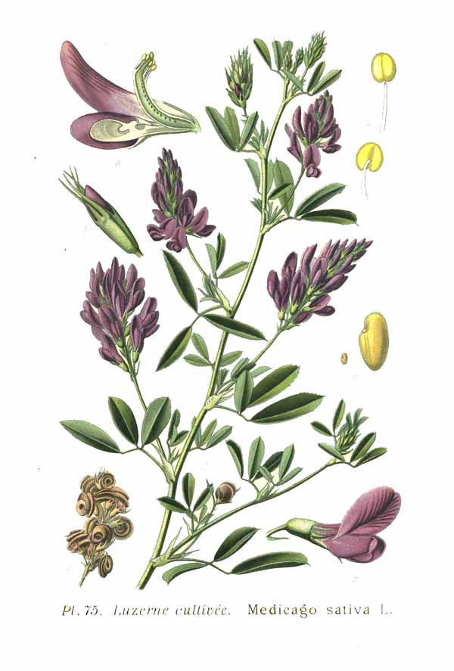
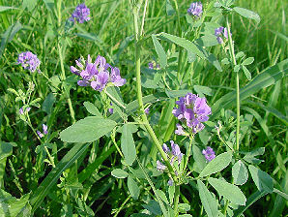
Medicago sativa
Common name: Alfalfa
Family: Leguminosae
Parts used: Herba

Slide 37
Constituents:
Alkaloids (aspragine, trigonelline); phytoestrogenic compounds (formometin, coumestrol); vitamins K, A, C and minerals Ca, K, Fe, Mg; saponins; coumarins, porphyrins, flavonoids, trace minerals, proteins.
Medicinal actions:
Nutritive, phytoestrogen, anti-tumor

Slide 38
Medicinal use:
The isoflavones (flavonoids) are estrogenic and antibacterial (Gm.- bacteria). Medicago contains many minerals and vitamins, and in addition, stimulates appetite and enhances overall nutrition. The action of Medicago on the reproductive system can be summarized as a restorative tonic. Medicago is phytoestrogenic and its action is to restore the strength and tone of the digestive, kidney, mammary, ovarian and uterine tissue.

Slide 39
Pharmacy:
Infusion: 1 tsp/cup water ; 1-2 cups TID. Tincture (1:5), 4-5 ml TID
Toxicity:
None reported.

Slide 40
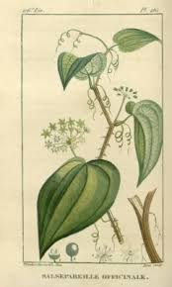
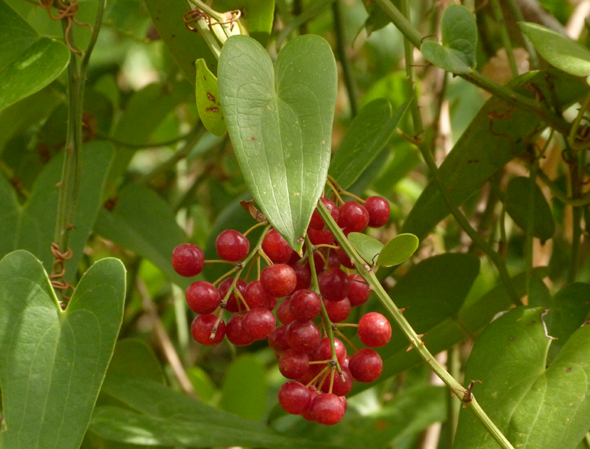
Smilax officinalis
Common name: Sarsaparilla
Family: Liliaceae
Parts used: Root

Slide 41
Constituents:
Steroidal & glycoside saponins (smilagenin, sarsasapogenin, sarsaparilloside, sarsaponin), flavonoids (quercitin), phytosterols, starch, resin, testosterone & cortin hormones (controversial), B-sitosterol, stigmasterol glycosides, oxalic acid, fatty acids

Slide 42
Medicinal actions:
General tonic, pituitary stimulant, metabolic stimulant, immuno-stimulant, antiseptic, antibiotic, Alterative, anti-inflammatory, anti-pruritic, anti-rheumatic, diaphoretic, alterative, aphrodisiac, testosteronic, progesteronic, diuretic, vulnerary

Slide 43
Medicinal use:
It has been used for chronic skin conditions such as psoriasis and other scaling skin diseases. It has also been used to relieve rheumatoid arthritis symptoms. Will balance the glandular system and hormones and can be used as a general tonic during menopause and improve debility and low libido.

Slide 44
Pharmacology:
Though there is no testosterone present in the plant, may exhibit testosterone-like and estrogen-like effects (eg. increase muscle mass, aphrodisiac effects). Steroidal saponins have not been shown to promote the production of sex hormones.
Cortin regulates the metabolism and promotes homeostatic function.
Pharmacy: Dried root: 1-4g, TID. Decoction: 1-2 tsp/cup water, simmer 20 min, TID. Tincture: (1:2, 45%), 3-6 ml QD.

Slide 45
Contraindications: None reported. Avoid high doses due to saponins causing GIT complaints
Toxicity: Long-term use may cause ulceration of the gastrointestinal mucosa.
Interactions: May increase the absorption or increase the elimination rate of some medications (theoretical based on saponins, no reports exist).

Slide 46
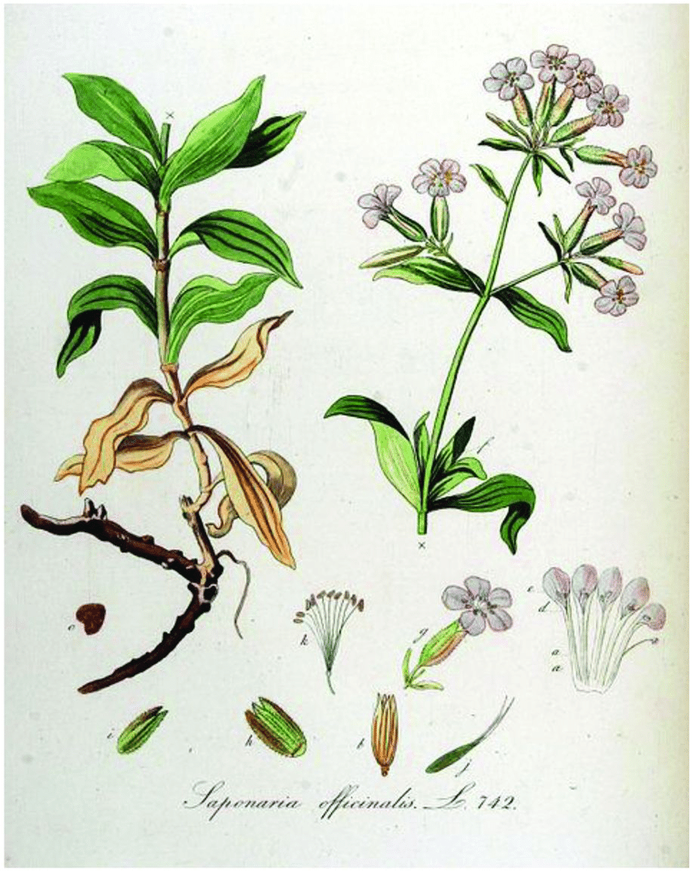
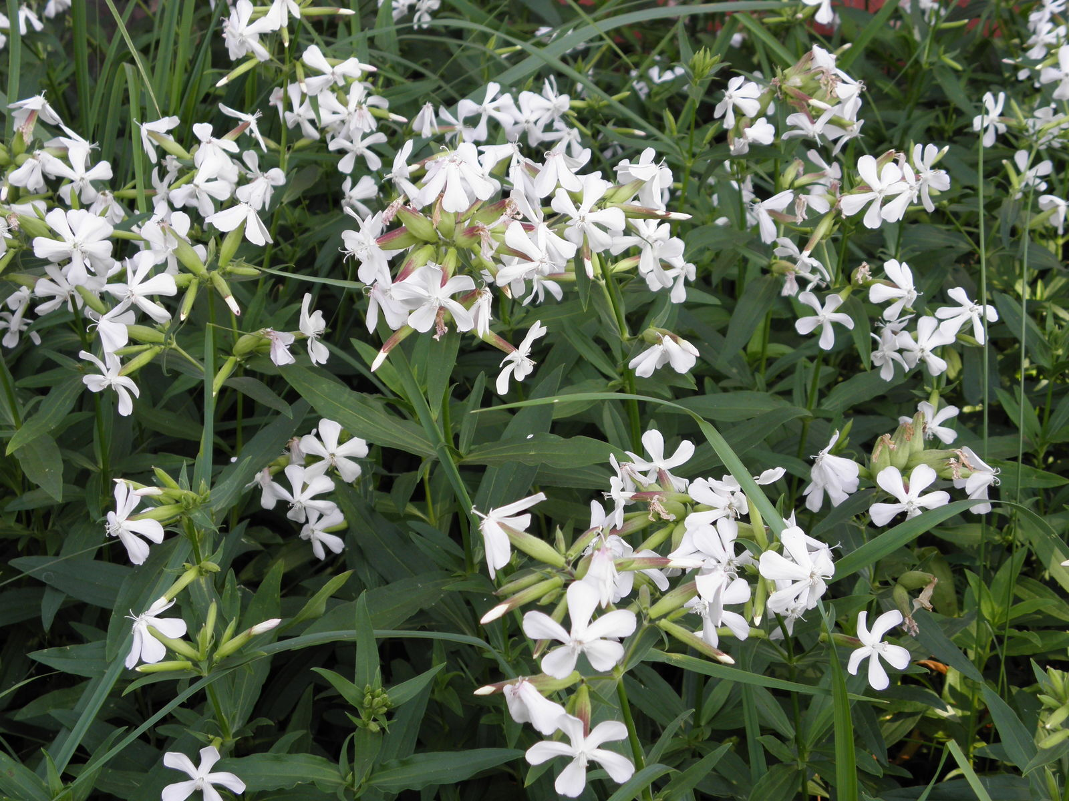
Saponaria officinalis
Common name: Soapwort
Family: Caryophyllaceae
Parts used: Dried root and leaves.

Slide 47
Constituents:
The soapwort’s rhizome contains saponins (up to 5%), flavonoids, sugars, resin, vitamin C and small amounts of essential oil.

Slide 48
Medicinal Properties
The saponins in the rhizome have a slight irritating effect on the respiratory and digestive system and the herb is regarded to have expectorant, diuretic, diaphoretic and laxative properties.
In herbal medicine, soapwort is mainly used as a remedy for a cough, bronchitis, and inflammation of the upper respiratory tract, usually in the form of a decoction.
Due to the herb’s irritating effect on the mucous membranes of the digestive tract, it stimulates the fluid secretion of the bronchi.
Soapwort also enhances the production and excretion of bile from the liver and gallbladder and it has been used as a natural treatment for constipation and bile duct diseases.

Slide 49
Medicinal use:
Soapwort's main medicinal use is as an expectorant. Its strongly irritant action within the gut is thought to stimulate the cough reflex and increase the production of a more fluid mucus within the respiratory passages. The whole plant, but especially the root, is alterative, antiscrophulatic, cholagogue, depurative, diaphoretic, mildly diuretic, expectorant, purgative, sternutatory and tonic. A decoction of the whole plant can be applied externally to treat itchy skin.

Slide 50
The plant has proved of use in the treatment of jaundice and other visceral obstructions, but is rarely used internally in modern herbalism due to its irritant effect on the digestive system. When taken in excess, it destroys red blood cells and causes paralysis of the vasomotor centre. See also the notes above on toxicity. The root is harvested in the spring and can be dried for later use. One of the saponins in this plant is proving of interest in the treatment of cancer, it is cytotoxic to the Walker Carcinoma in vitro.

Slide 51
Pharmacy:
Decoction, Extract or the inspissated juice, Fluid extract,
An extract of soapwort for internal use can be made by adding two teaspoons of the dried, finely cut rhizomes to a glass of cold water and soak it overnight. After the extract has been strained it can be used in small doses divided throughout the day.
Alternatively, one teaspoon of dried herb can be added to a cup of boiling water and then allow the tea to draw until it has completely cooled down.
For internal use, a daily dosage of soapwort should not exceed 1.5 grams of the dried rootstock.

Slide 52
Other uses of Soapwort: A soap can be obtained by boiling the whole plant (but especially the root) in water. It is a gentle effective cleaner, used especially on delicate fabrics that can be harmed by modern synthetic soaps (it has been used to clean the Bayeaux tapestry). It effects a lustre in the fabric. The best soap is obtained by infusing the plant in warm water. The roots can be dried and stored for later use. The plant is sometimes recommended as a hair shampoo, though it can cause eye irritations. The plant spreads vigorously and can be used as a ground cover when planted about 1 metre apart each way.

Slide 53
Known hazards of Saponaria officinalis:
The plant contains saponins. Although toxic, these substances are very poorly absorbed by the body and so tend to pass through without causing harm. They are also broken down by thorough cooking. Saponins are found in many plants, including several that are often used for food, such as certain beans. It is advisable not to eat large quantities of food that contain saponins. Saponins are much more toxic to some creatures, such as fish, and hunting tribes have traditionally put large quantities of them in streams, lakes etc in order to stupefy or kill the fish.

Slide 54
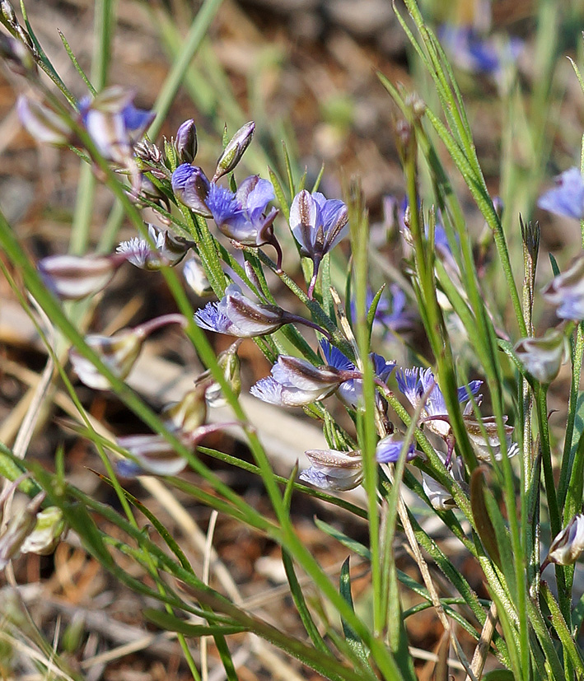
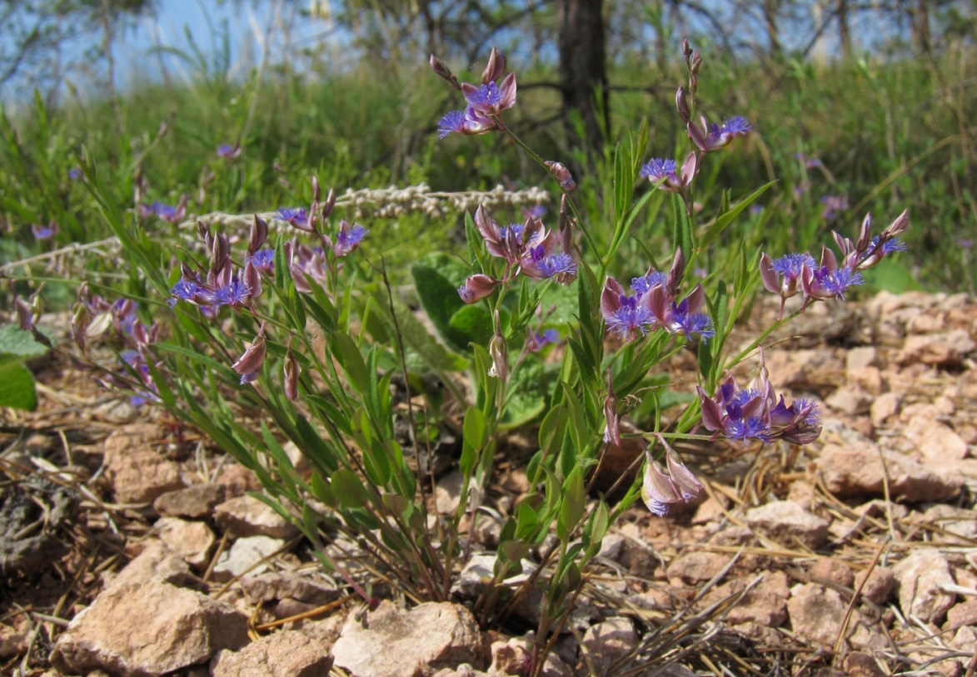
Polygala tenuifolia and
Polygala sibirica
Common name: Yuan Zhi
Family: Polygalaceae
Parts used: Dried root
Polygala tenuifolia
Polygala sibirica

Slide 55
Constituents:
More than 140 compounds have been isolated from Polygalae Radix, including saponins, xanthones, oligosaccharide esters, and so on.
Medicinal actions:
The compounds and extracts isolated from Polygalae Radix possess wide-ranging pharmacological activities, such as neuroprotective, antidepressant, hypnotic-sedative, anti-inflammatory, antiviral, antitumor, antioxidant, antiaging, and antiarrhythmic effects, among others.

Slide 56
Medicinal use:
The roots are diuretic, expectorant, haemolytic and sedative. Their use lowers the blood pressure. They are used in the treatment of coughs, bronchitis, insomnia, infantile convulsions, amnesia, sexual impotency etc. The plant is also considered to be analgesic, diuretic, expectorant and nervine.
Also, the Polygalae Radix has been widely used in the treatment of insomnia, forgetfulness, depression, cough, palpitation, and other diseases.

Slide 57
The clinical practice of traditional Chinese medicine has proved that raw Polygalae Radix can irritate the throat.
Modern studies have found that raw Polygalae Radix exhibits a certain degree of toxicity to the gastrointestinal tract after long-term use or excessive doses and that its main toxic components are saponins. Thus, Polygalae Radix is usually processed, and/or combined with other herbs to reduce gastrointestinal irritation.

Slide 58
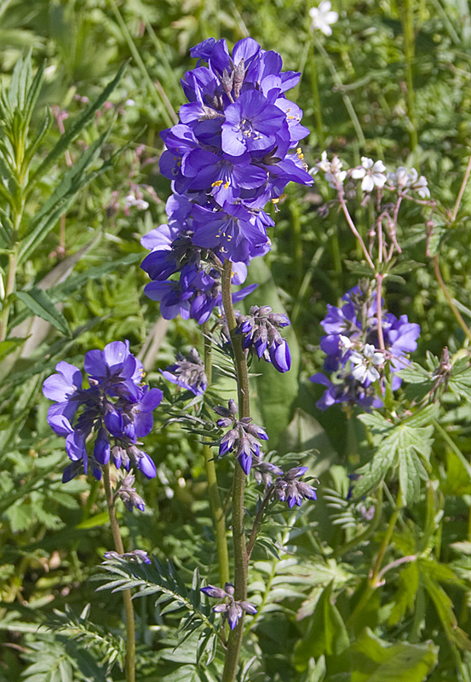
Polemonium coeruleum
Common name: Jacob's Ladder
Family: Polemoniaceae
Parts used: Herb

Slide 59
Constituents:
The entire plant contains triterpene saponins, triterpene glycosides, resins, organic acids, essential oils, fatty oils, and many macro- and micro-elements

Slide 60
Documented effects:
Polemonium caeruleum contains saponins that act as an expectorant.
The plant has also been shown to have homeostatic effects and acts as a highly effective sedative (8–10 times that of Valeriana), but can be fatal to experimental animals at high doses. Preparations are used as expectorants, sedatives, treatments for stomach and duodenum ulcers, epilepsy, and chronic and acute bronchitis.

Slide 61
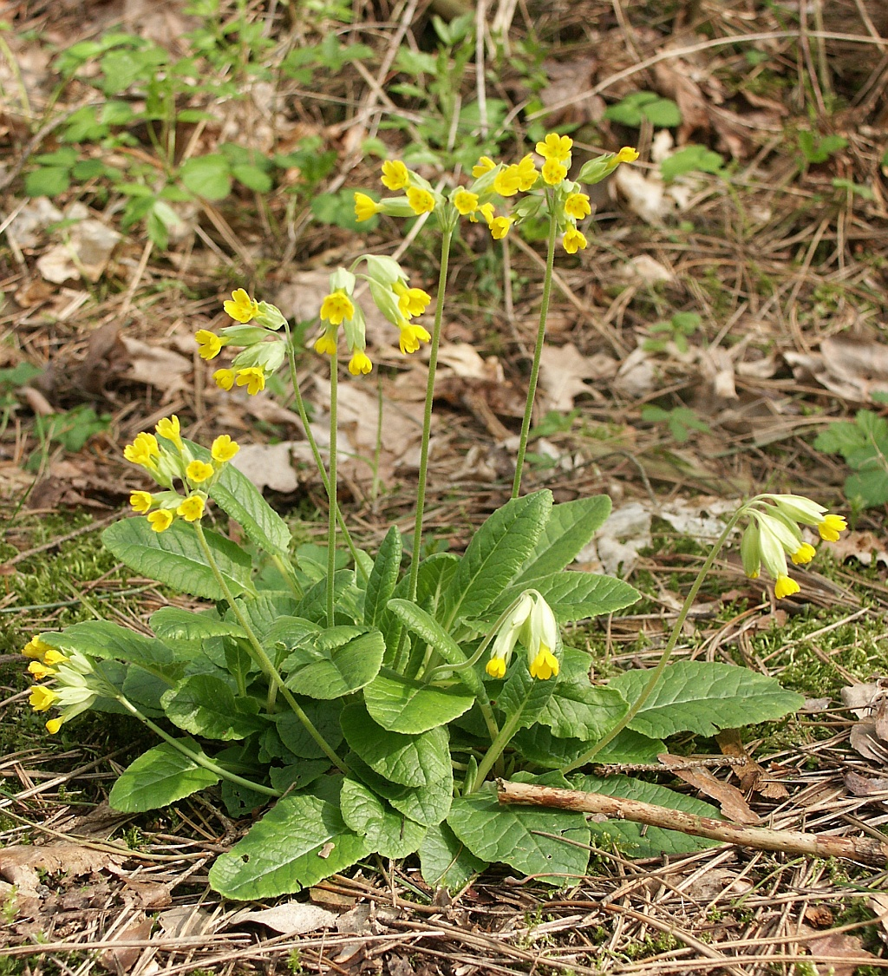
Primula veris (Synonyms: Primula officinalis)
Common name: Cowslip
Family: Polemoniaceae
Parts used: Flowers, leaves, root.

Slide 62
Constituents:
The roots and the flowers have somewhat of the odour of Anise, due to their containing some volatile oil identical with Mannite. Their acrid principle is Saponin.
Medicinal Action :
Sedative, antispasmodic.
Known hazards of Primula veris:
Some people are allergic to the stamens of this plant, though such cases are easily treated.

Slide 63
Medicinal Uses:
Cowslips are an underused but valuable medicinal herb. They have a very long history of medicinal use and have been particularly employed in treating conditions involving spasms, cramps, paralysis and rheumatic pains. The plant contains saponins, which have an expectorant effect, and salicylates which are the main ingredient of aspirin and have anodyne, anti-inflammatory and febrifuge effects. This remedy should not be prescribed for pregnant women, patients who are sensitive to aspirin, or those taking anti-coagulant drugs such as warfarin. The flowers and the leaves are anodyne, diaphoretic, diuretic and expectorant. They are harvested in the spring and can be used fresh or dried. The yellow corolla of the flower is antispasmodic and sedative. They are recommended for treating over-activity and sleeplessness, especially in children.

Slide 64
They are potentially valuable in the treatment of asthma and other allergic conditions. At one time an oil was produced by maceration of the flowers, this has an antiecchymotic effect (treats bruising). The root contains 5 - 10% triterpenoid saponins which are strongly expectorant, stimulating a more liquid mucous and so easing the clearance of phlegm . It has been dried and made into a powder then used as a sternutatory. The root is also mildly diuretic, antirheumatic and slows the clotting of blood. It is used in the treatment of chronic coughs (especially those associated with chronic bronchitis and catarrhal congestion), flu and other febrile conditions. The root can be harvested in the spring or autumn and is dried for later use. The leaves have similar medicinal properties to the roots but are weaker in action. A homeopathic remedy is made from the plant. It is used in the treatment of kidney complaints and catarrh.

Slide 65
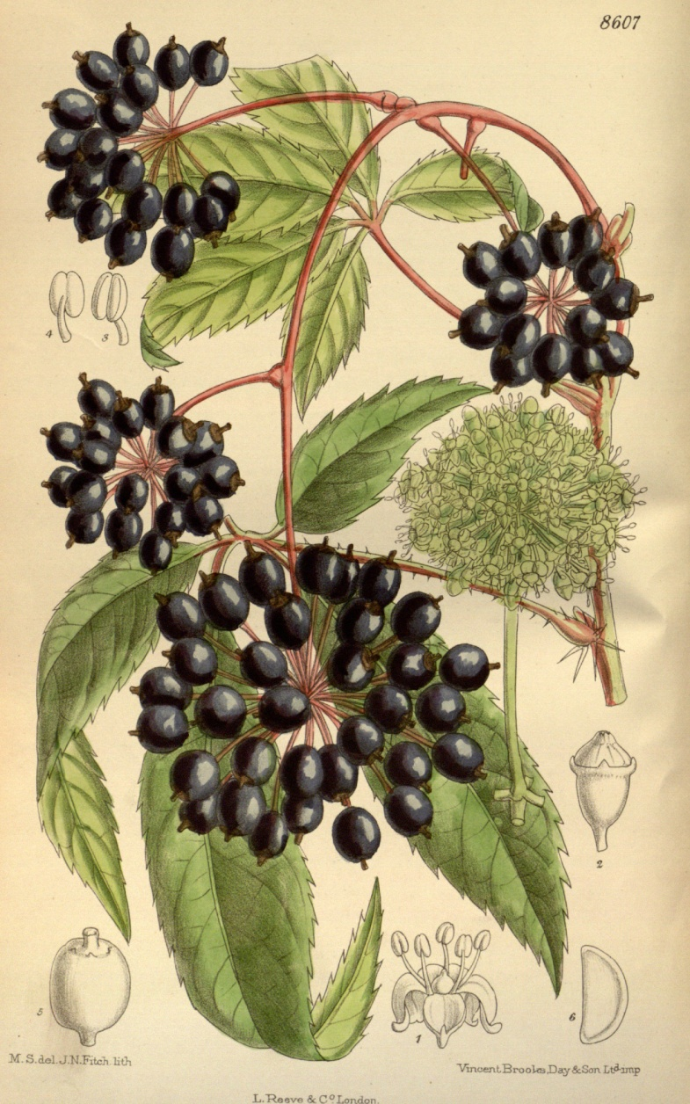
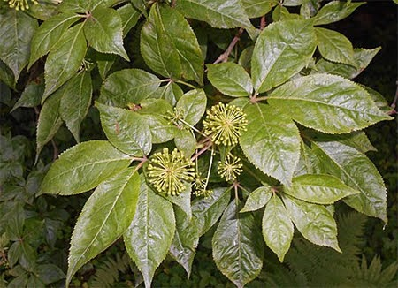
Eleutherococcus senticosus
Common name: Siberian Ginseng
Family: Araliaceae
Parts used: Root

Slide 66
Constituents:
Eleutherosides (glycosides) including eleutherosides B and E; Syringin; Phenylpropanes; Polysaccharide; Ciwujianoside. Phenolic compounds, triterpenoid saponins, lignans, coumarins, volatile oils.
Medicinal actions:
Adaptogen & general tonic, antioxidant, chemoprotective, immuno-modulator & stimulant, hypertensive (in a hypotensive state), cardiotonic, hypoglycemic, circulatory stimulant, anti-coagulant, bitter.

Slide 67
Medicinal use:
Eleutherococcus is an adrenal adaptogen and increases mental alertness and physical endurance. It inhibits hypertrophy of adrenal and thyroid glands by reducing extent of the fight or flight reaction and reduces the exhaustive effects of long term stress. Treatment of chronic viral infections, prevention of infections, cancer prevention, adjuvant cancer therapy, treatment of chronic illness and fatigue, alleviation of chronic stress, and reduction of damage from heavy metal and pesticide toxicity.

Slide 68
Pharmacology:
Effects are due to a combination of components, primarily eleutherosides B and E
Pharmacy:
Standardized capsule: 100mg (standardized to greater than 1% eleutheroside E): 200 – 400 mg daily in 2 doses. Whole powder: 2-4 g daily in two doses. Tincture (1:2, 25%), 2-8ml QD. Best taken in the morning and at noon to match the adrenal gland rhythm. Pause dosing, 6 weeks on 2 weeks off

Slide 69
Contraindications: Best to avoid in children and those that are nervous, tense, manic or overly energetic.
Toxicity: High doses may cause palpitations, insomnia, hypertension and tachycardia.
Interactions: Avoid use with stimulants, alcohol, barbiturates, anti-psychotics, digoxin, and anticoagulants.

Slide 70
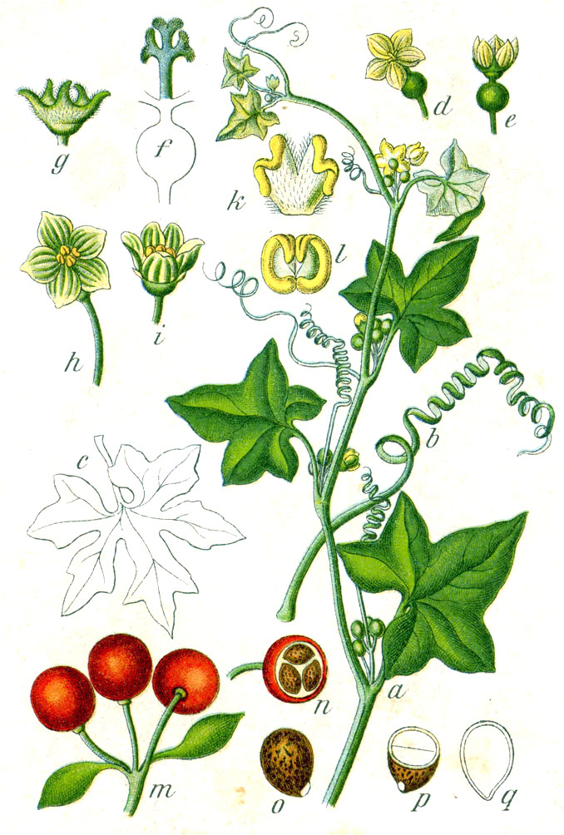
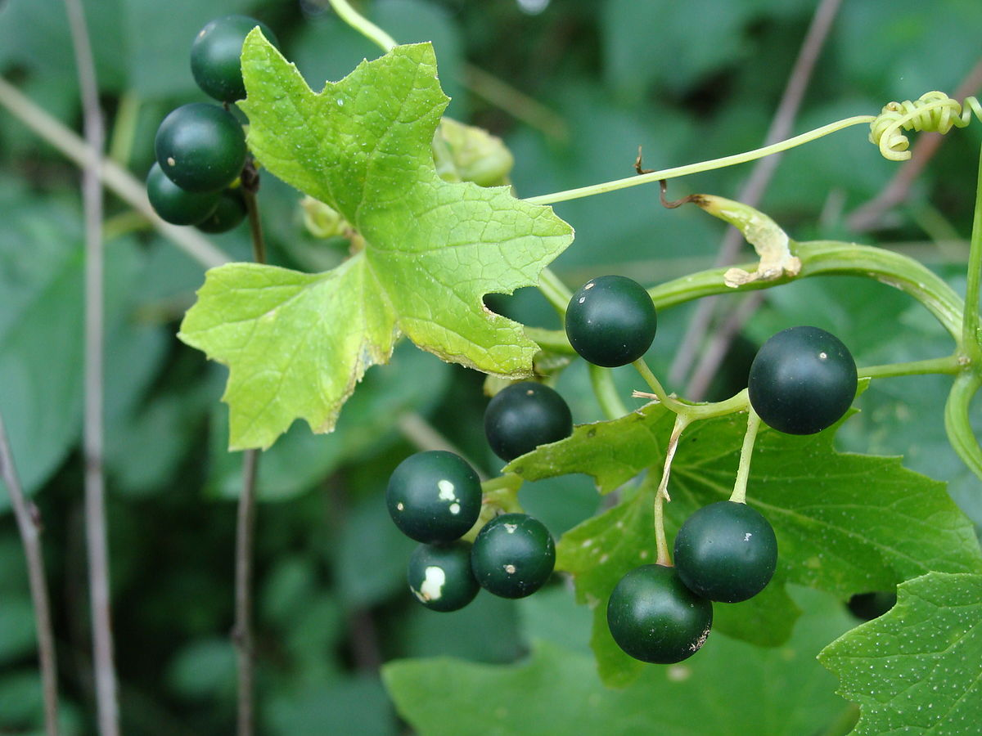
Bryonia alba/diocia
Common name: White bryony
Family: Curcurbitaceae
Part Used: Dried root

Slide 71
Constituents: Cucurbitacins, alkaloids, polyhydroxy-unsaturated fatty acids, volatile oil, tannins, resin (poisonous).
Medicinal actions: Adonyne, sedative, immuno-modulating, hypotensive, counter-irritant & rubifacient, diaphoretic, cathartic, emetic, anti-rheumatic, anti-tumor, anti-viral, expectorant

Slide 72
Medicinal use:
Bryonia is considered to possess toxic effects in relatively small doses, and is therefore infrequently used. It has a specific for the fever of rheumatic fever and for the cardiac complications of rheumatic fever. It is useful in pulmonary edema and pleurisy with associated cardiac insufficiency. Is also used for rheumatic conditions of the joints. It helps to relieve pain and stiffness by reducing fluid in the joint space. Used topically for joint/muscular pains, sciatica and myalgia.

Slide 73
Pharmacy: Tincture (1:10, 60%), 0.5 – 1ml TID; 10 ml weekly maximum. Dried root: 0.5-2g, TID. Infusion: 1 tsp/cup q 1-2 hours.
Toxicity: Symptoms of toxicity are poorly understood though include: colic, vomiting, diarrhea, gastro-enteritis, cardiac depression with weak, thready pulse, fall of temperature, mydriasis, congestive headaches, dizziness, delirium, cold perspiration, and death.
Contraindications: Avoid in pregnancy, lactation, with some GIT disorders.
Interactions: None known.

